Slide 1

Department of Computer Engineering
Nonlinear Data Structure
Data Structure 01CE0301 / 3130702
Unit#3
Ravikumar Natarajan

Slide 2
Unit#3: Nonlinear Data Structure
Highlights
Trees
Graphs

Slide 3
Unit#3: Nonlinear Data Structure
Tree deﬁnitions and their concepts
Representation of binary tree
Binary tree traversal
Binary search trees
General trees vs binary trees
Threaded binary tree
Applications of Trees
Balanced tree and its mechanism
Height and Weight Balanced Trees
Highlights
Trees
Graphs

Slide 4
Unit#3: Nonlinear Data Structure
Every data item is attached to several other data items in a way that is speciﬁc for reﬂecting relationships.
The data items are not arranged in a sequential structure.
Ex: Trees, Graphs
Non-Linear Data Structure
A
A
C
B
C
E
B
D
D
E
E

Slide 5
Unit#3: Nonlinear Data Structure
Non-Linear Data Structure
Characteristics:
Not stored in sequential order
Branches to more than one node
Can’t be traversed in a single run
Data members are not processed one after another

Slide 6
Unit#3: Nonlinear Data Structure
A tree is a Multilevel data structure that represent a hierarchical relationship between the set of individual elements called nodes.
Tree
A
B
C
D
E

Slide 7
Unit#3: Nonlinear Data Structure
A vertex (or node) is a simple object that can have a name and can carry other associated information. Left pointer, Right pointer and a data element.
The ﬁrst or top node in a tree is called
A
the root node.
An edge is a connection between
Tree
B
C
two vertices.
A path in a tree is a list of
distinct vertices in which successive vertices are connected by edges in the tree.
Nodes with no children are leaves or terminal nodes.
D
E

Slide 8
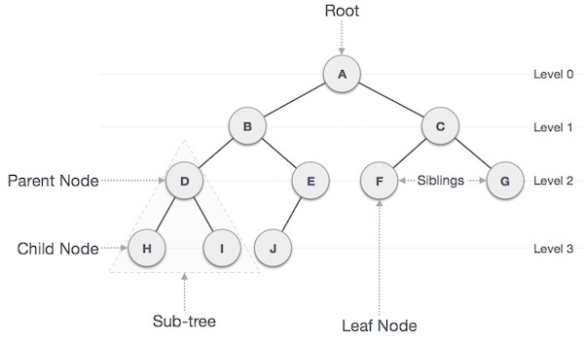
Tree

Slide 9
Unit#3: Nonlinear Data Structure
A binary tree is a tree where each node has exactly zero, one or two children.
Each parent can have no more than 2 children.
A
Binary Trees
B
C
D
E
D, E, C are having zero or no successors and thus are said to be empty sub-trees.

Slide 10
Unit#3: Nonlinear Data Structure
A
B
C
D
E
Array Representation of binary tree
If K is the parent, then (Consider K as root node)
Left child – 2*K = 2*1 = 2
Right child – (2*K)+1 = (2*1)+1 = 3

Slide 11
Unit#3: Nonlinear Data Structure
A
B
C
Linked List Representation of binary tree
D
E
A
B
 | C
 | D
 | E

Slide 12
Unit#3: Nonlinear Data Structure
Siblings: B and C are said to be left and right child of A, so B and C are known as siblings.
All nodes at same level and share the same parent are known as siblings.
Siblings
A
B
C
D
E

Slide 13
Unit#3: Nonlinear Data Structure
Every node in a binary tree is having Level Number.
Root node is deﬁned at level 0.
Left and Right child of Root node is at level 1.
So, a child’s level number is deﬁned as parent’s level number + 1.
Level Number
A
B
C
D
E

Slide 14
Unit#3: Nonlinear Data Structure
Degree of a node is equal to the number of children it has.
Degree of leaf node is always zero.
Degree of A =
Degree of B =
Degree of C =
Degree of D =
Degree of E =
Degree
A
B
C
D
E

Slide 15
Unit#3: Nonlinear Data Structure
The depth of a node is the number of edges present in path from the root node of a tree to that node.
The height of a node is the number of edges present in the longest path connecting that node to a leaf node.
Depth and Height
Depth of B =
Height of B =
1
1
A
B
C
Depth of D =
Height of D =
2
0
D
E

Slide 16
Unit#3: Nonlinear Data Structure
If every non leaf node in a binary tree has nonempty left and right subtrees, then tree is called a strictly binary tree.
A strictly binary tree with n leaves always contains 2n-1 nodes.
A strictly binary tree is a tree in which every node other than the leaves has two children.
Strictly Binary Trees
A
A
B
C
B
C
D
E
E
D
Notes:
Each node can have either 0 or 2 nodes. A strictly binary tree is a tree in which every node other than the leaves has two children.

Slide 17
Unit#3: Nonlinear Data Structure
A binary tree T with n levels is complete if all levels except possibly the last are completely full, and the last level has all its nodes to the left side.
Complete Binary Tree
A
A
A
B
C
B
C
B
C
D
E
D
E
D
E
F

Slide 18
Unit#3: Nonlinear Data Structure
A
B
C
Complete Binary Tree
D
E
Max #of Nodes at Level(I):
Level 0 has 2^0 = 1 Node
Level 1 has 2^1 = 2 Node
Level 2 has 2^2 = 4 Node

Slide 19
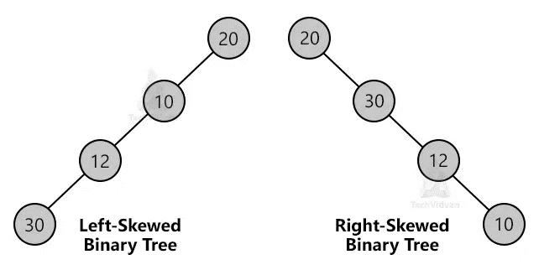
A skewed binary tree could be skewed to left or right. In left skewed, most of the nodes have left child without corresponding right child. Similarly, for the right skewed.
Skewed Binary Tree

Slide 20
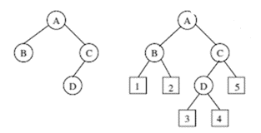
In extended binary tree each sub tree is replaced by a failure node. A failure node is represented as
Any binary tree can be converted into a extended binary tree by replacing each empty subtree by a failure node.
Extended Binary Tree

Slide 21
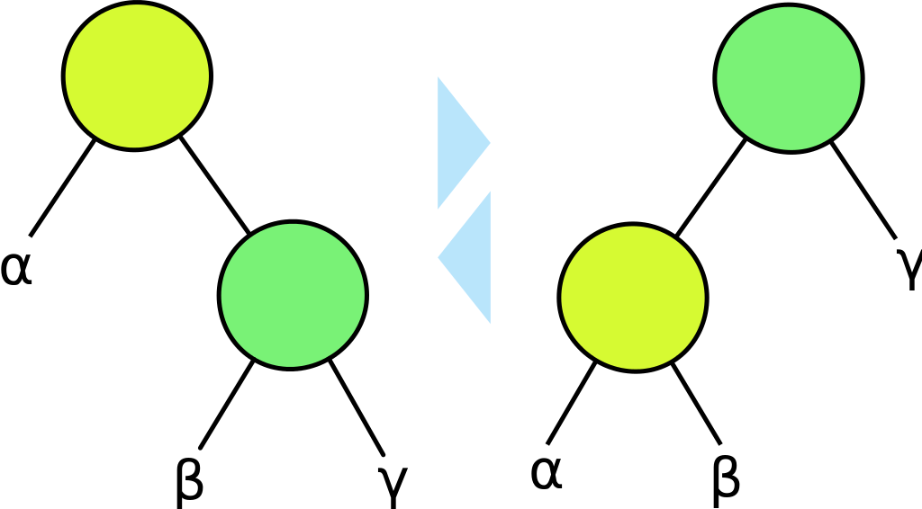
If the ratio of the weight of the left subtree of every node to the weight of the subtree rooted at the node is between a and 1-a then the tree is WBT of ratio a.
Weight-balanced binary trees (WBTs) are a type of self-balancing binary search trees that can be used to implement dynamic sets, dictionaries (maps) and sequences.
Weight Balanced Tree

Slide 22
Unit#3: Nonlinear Data Structure
A strictly binary tree is a tree in which every node other than the leaves has two children.
A perfect binary tree is a full binary tree in which all leaves are at the same depth or same level. 2 or no children. Node = 2^{h+1} -1.
A complete binary tree is a binary tree in which every level, except possibly the last, is completely ﬁlled, and all nodes are as far left as possible.
A skewed binary tree is either left or right skewed.
A extended binary tree’s subtree is replaced by failure node.
A weight balanced tree self balancing tree. Rotations are applied to restore weight balance.
Types of Binary tree

Slide 23
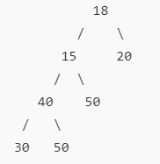
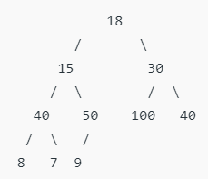
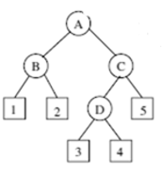
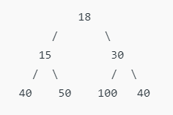
Examples of Full, Complete, Perfect, Extended Binary tree

Slide 24
Unit#3: Nonlinear Data Structure
Often, one wishes to visit each of the nodes in a tree and examine the value there, a process called Traversal.
There are several common orders in which the nodes can be visited, and each has useful properties that are exploited in algorithms based on binary trees.
Binary Tree Traversal
Pre-Order: Root, Left child, Right child
In-Order: Left child, Root, Right child
Post-Order: Left Child, Right child, Root

Slide 25
Unit#3: Nonlinear Data Structure
Pre-Order: Root, Left child, Right child
A
B
C
Pre-order Traversal
D
E
A, B, D, E, C

Slide 26
PREORDER(TREE):
Unit#3: Nonlinear Data Structure
Step 1: IF TREE != NULL perform step 2, 3 and 4 Step 2: Write “TREE->DATA”
Step 3: PREORDER(TREE->LEFT)
Step 4: PREORDER(TREE->RIGHT)
Step 5: END
Pre-order Algorithm

Slide 27
Unit#3: Nonlinear Data Structure
In-Order:Left child, Root, Right child
A
B
C
In-order Traversal
D
E
D, B, E, A, C

Slide 28
INORDER(TREE):
Unit#3: Nonlinear Data Structure
Step 1: IF TREE != NULL perform step 2, 3 and 4
Step 2: INORDER(TREE->LEFT)
Step 3: Write “TREE->DATA” Step 4: INORDER(TREE->RIGHT)
Step 5: END
In-order Algorithm

Slide 29
Unit#3: Nonlinear Data Structure
Post-Order:Left child, Right child, Root
A
B
C
Post-order Traversal
D
E
D, E, B, C, A

Slide 30
POSTORDER(TREE):
Unit#3: Nonlinear Data Structure
Step 1: IF TREE != NULL perform step 2, 3 and 4
Step 2: POSTORDER(TREE->LEFT)
Step 3: POSTORDER(TREE->RIGHT)
Step 4: Write “TREE->DATA” Step 5: END
Post-order Algorithm

Slide 31
Unit#3: Nonlinear Data Structure
In Level-order traversal, all the nodes at a level are accessed before going to the next level.
This is also known as breadth-ﬁrst traversal algorithm.
Level-order traversal
A
B
C
D
E
A, B,C, D, E

Slide 32
Unit#3: Nonlinear Data Structure
A
B
C
D
E
F
Different Traversals
G
H
I
Depth-ﬁrst:
Pre-order (root, left, right):
In-order (left, root, right):
Post-order (left, right, root):
Breadth-ﬁrst:
Level-order:

Slide 33
Traversal Examples
Unit#3: Nonlinear Data Structure

Slide 34
Unit#3: Nonlinear Data Structure
Inorder sequence: D B E A F C (Left, root, right)
Preorder sequence: A B D E C F (Root, Left, Right)
Construction of Tree from Travarsal
Notes:
a

Slide 35
Inorder: 8, 4, 10, 9, 11, 2, 5, 1, 6, 3, 7
Unit#3: Nonlinear Data Structure
Preorder: 1, 2, 4, 8, 9, 10, 11, 5, 3, 6, 7
Construction of Tree from Travarsal

Slide 36
Inorder: 7 4 2 5 1 8 6 9 3
Unit#3: Nonlinear Data Structure
Postorder: 7 4 5 2 8 9 6 3 1
Construction of Tree from Travarsal

Slide 37
Unit#3: Nonlinear Data Structure
Construct Tree
Exercise:
Inorder: 15, 30, 35, 40, 45, 50, 60, 70, 72, 75, 77, 80
Preorder: 50, 30, 15, 40, 35, 45, 70, 60, 80, 75, 72, 77
Notes:
https://algorithms.tutorialhorizon.com/make-a-binary-tree-from-given-inorder-and-preorder-traveral/

Slide 38
Unit#3: Nonlinear Data Structure
A binary tree which conforms to the following properties is called a binary search tree.
Properties:
Each value (key) in the tree exists at most once (i.e. no duplicates).
The "greater-than" and "less-than" relations are well deﬁned for the data value.
Sorting constraints:- for every node n:
Binary Search Tree
All data in the left subtree of n is less than the data in the root of that subtree.
All data in the right subtree of n is greater than the data in the root of that subtree.

Slide 39
Unit#3: Nonlinear Data Structure
Trees (with some ordering e.g., BST) provide moderate access/search (quicker than Linked List and slower than arrays).
Trees provide moderate insertion/deletion (quicker than Arrays and slower than Unordered Linked Lists).
Like Linked Lists and unlike Arrays, Trees don’t have an upper limit on number of nodes as nodes are linked using pointers.
Binary Search Tree
12
8
18
John
5
10
14
20
James
Joseph
7
Jack
Jesus
BST of Numbers
BST of Names

Slide 40
SearchBST(TREE)
Unit#3: Nonlinear Data Structure
IF TREE->DATA = VAL OR TREE = NULL
THEN Return TREE
ELSE IF VAL < TREE->DATA
Return SearchBST(TREE->LEFT, VAL) ELSE
Return SearchBST(TREE->RIGHT, VAL)
Operations on BST - Search

Slide 41
Unit#3: Nonlinear Data Structure
Create a BST with following elements.
45, 39, 56, 12, 34, 78, 32, 10, 89, 54, 67, 81
Binary Search Tree

Slide 42

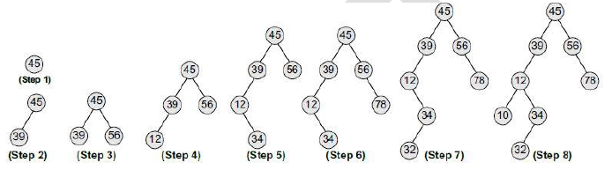
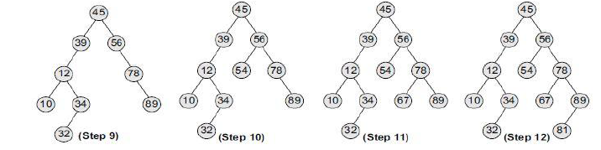
Binary Search Tree

Slide 43
Unit#3: Nonlinear Data Structure
Create a BST with following elements.
50, 70, 60, 20, 90, 10, 40, 100
Binary Search Tree

Slide 44
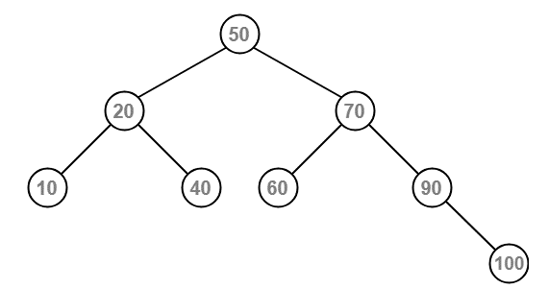
Binary Search Tree

Slide 45
BST Operations:
Unit#3: Nonlinear Data Structure
Initialize
Find
Make empty
Insert
Delete
Create
Find min
Find max
Operations in BST

Slide 46
InsertBST(TREE)
Unit#3: Nonlinear Data Structure
IF TREE = NULL THEN
Allocate memory for TREE SET TREE -> DATA = VAL
SET TREE -> LEFT = TREE -> RIGHT = NULL
Return TREE
ELSE IF VAL < TREE -> DATA
TREE->LEFT = InsertBST(TREE->LEFT, VAL) ELSE
TREE->RIGHT = InsertBST(TREE->RIGHT, VAL)
Operations on BST - Insert

Slide 47
Unit#3: Nonlinear Data Structure
Operations on BST - Delete
CASE 1: Delete a node that has no children
CASE 2: Delete a node that has one child
CASE 3: Delete a node that has two children
In order predecessor- Find largest in left subtree & replace
In order successor- Find smallest in right subtree & replace

Slide 48
Unit#3: Nonlinear Data Structure
CASE 1: Delete a node that has no children
Operations on BST - Delete
Notes:
12, 8, 18, 5, 10, 14, 20, 7

Slide 49
Unit#3: Nonlinear Data Structure
CASE 2: Delete a node that has one child
Operations on BST - Delete

Slide 50
Unit#3: Nonlinear Data Structure
CASE 3: Delete a node that has two children
Operations on BST - Delete

Slide 51
DeleteBST(TREE)
Unit#3: Nonlinear Data Structure
IF TREE = NULL THEN
Write ‘Value not found’
ELSE IF VAL < TREE -> DATA THEN
TREE->LEFT = DeleteBST(TREE->LEFT, VAL) ELSE IF VAL > TREE -> DATA THEN
TREE->RIGHT = DeleteBST(TREE->RIGHT, VAL) ELSE IF TREE->LEFT=NULL AND TREE->RIGHT=NULL THEN
free(TREE) Return NULL
Operations on BST - Delete

Slide 52
DeleteBST(TREE)
Unit#3: Nonlinear Data Structure
ELSE IF TREE->RIGHT=NULL THEN tmp=TREE->LEFT
free(TREE) Return tmp
ELSE IF TREE->LEFT=NULL THEN tmp=TREE->RIGHT
free(TREE) Return tmp
ELSE IF TREE->LEFT!=NULL AND TREE->RIGHT!=NULL THEN
tmp=getPreDec(TREE); TREE->DATA=tmp;
TREE->LEFT=DeleteBST(TREE->LEFT,tmp);
Return TREE;
Operations on BST - Delete

Slide 53
Time Complexity
For Insertion, deletion, search the best and average case complexity is O(log n)
Worst case is O(n)
Binary Search Tree Complexities
Space Complexity
For all operations is O(n)
n is number of nodes in the tree.

Slide 54
Construct BST for the following data:
10, 3, 15, 22, 6, 45, 65, 23, 78, 34, 5
Traverse the final tree in Pre-order, In-order, Post-order
2. Insert the following in BST
7, 39, -2, 0, 3, 42, 20, 5, 40
Perform deletion operation
BST Task
Notes:
10 3 6 5 15 22 45 23 34 65 78 - pre

Slide 55
Unit#3: Nonlinear Data Structure
General trees are those in which the number of subtrees for any node is not required to be 0, 1, or 2.
The tree may be highly structured and therefore have 3 subtrees per node in which case it is called a ternary tree.
However, it is often the case that the number of subtrees for any node may be variable. Some nodes may have 1 or no subtrees, others may have 3, some 4, or any other combination.
General Trees

Slide 56
Root of binary tree BT = Root of general tree GT
Left child of node in BT = Leftmost child of the node in GT
Right child of node in BT = Right sibling of the node in GT
1
2 3 4
5 6 7
8 9
General Trees

Slide 57
General Trees

Slide 58
Unit#3: Nonlinear Data Structure
8
2
7
30
Convert General Tree to Binary Tree
10
15
5
12
20
16
23
18
19
11
14
28

Slide 59
Unit#3: Nonlinear Data Structure
Threaded binary tree is a simple binary tree but they have a speciality that null pointers of leaf node of the binary tree is set to inorder predecessor or inorder successor.
The main idea behind setting such a structure is to make the inorder and preorder traversal of the tree faster without using any additional data structure(e.g auxilary stack) or memory to do the traversal.
A Threaded Binary Tree is a binary tree in which every node that does not have a right child has a THREAD (in actual sense, a link) to its INORDER successor.
By doing this threading we avoid the recursive method of traversing a Tree, which consumes a lot of memory and time.
Threaded Binary Tree

Slide 60
Unit#3: Nonlinear Data Structure
Single Threaded Binary Tree
Double Threaded Binary Tree
Single Threaded Binary Tree: Here only the right NULL pointer are made to point to inorder successor.
Double Threaded Binary Tree: Here both the right as well as the left NULL pointers are made to point inorder successor and inorder predecessor respectively. (here the left threads are helpful in reverse inorder traveral of the tree )
Types of Threaded Binary Tree

Slide 61
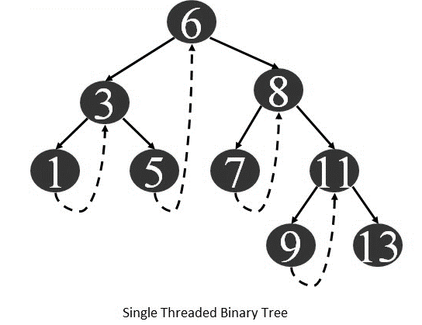
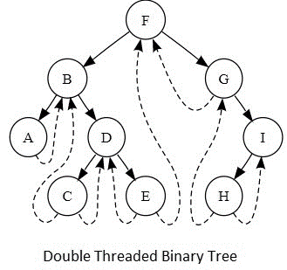
Unit#3: Nonlinear Data Structure
Types of Threaded Binary Tree

Slide 62
Unit#3: Nonlinear Data Structure
Let's make the Threaded Binary Tree out of a normal binary tree:
A
Threaded
B
C
Binary Tree
D
E

Slide 63
Unit#3: Nonlinear Data Structure
Advantage
By doing threading we can avoid a lot of memory and time caused in recursion.
The node can keep record of its root .
Threaded Binary Tree
Disadvantage
This makes the Tree more complex.
More prone to errors.

Slide 64
Unit#3: Nonlinear Data Structure
One more example:
8
Threaded Binary Tree
2
7
10
15
12
20
14
28
18
19
11

Slide 65
Unit#3: Nonlinear Data Structure
Expression Trees
Binary Trees are widely used to store algebraic expressions.
Binary tree is a tree in which all nodes contain zero, one or two children.
The expression trees have been implemented as binary trees mainly because binary trees allows you to quickly ﬁnd what you are looking for.
Expression Tree example: (a-b)+(c*d)
Application of Trees

Slide 66
Unit#3: Nonlinear Data Structure
Tournament Trees
In tournament of Chess or Cricket, n number of players participate.
To declare a winner among them, a couple of matches are played.
If there are 8 players then Round 1 will be having 4 matches and 4 winners.
Within Round 2, 2 matches and 2 winners.
At Round 3, 1 match and 1 winner as root node of our tree.
Application of Trees

Slide 67
Unit#3: Nonlinear Data Structure
Manipulate hierarchical data.
Make information easy to search (see tree traversal).
Router algorithms
Trees can hold objects that are sorted by their keys.
Application of Trees

Slide 68
Unit#3: Nonlinear Data Structure
Tree deﬁnitions and their concepts
Representation of binary tree
Binary tree traversal
Binary search trees
General trees vs binary trees
Threaded binary tree
Applications of Trees
Balanced tree and its mechanism
Height and Weight Balanced Trees
Till Now
Trees
Graphs

Slide 69
Unit#3: Nonlinear Data Structure
Tree deﬁnitions and their concepts
Representation of binary tree
Binary tree traversal
Binary search trees
General trees vs binary trees
Threaded binary tree
Applications of Trees
Balanced tree and its mechanism
Height and Weight Balanced Trees
Up Next
Trees
Graphs

Slide 70
Thank You.
Unit#3: Nonlinear Data Structure

